Slide 1
Toni Pippins- Poole Dallas County Elections Administrator
January 10,2020 TAEA – iGo Presentation
Fostering excellence in public service through Education, Innovation and Networking.

Slide 2
Who is iGo?
History
In 2016, The National Association of County Recorders, Election Officials, and Clerks (NACRC) and the International Association of Clerks, Recorders, Election Officials, and Treasurers (IACREOT) merged to form the International Association of Government Officials (iGO)

Slide 3
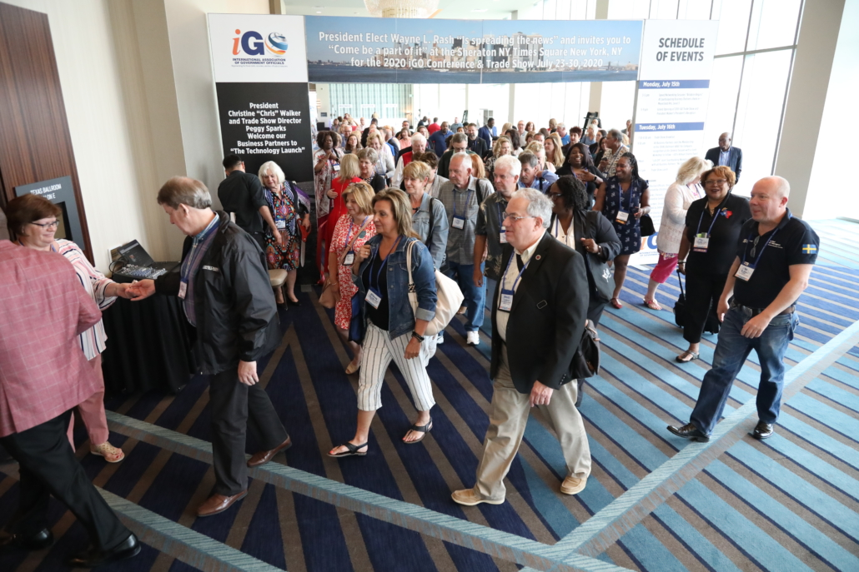
Mission & Vision
Equipping Clerks, Election Officials, Recorders and Treasurers with professional training and leadership development through;
Industry specific education
An accredited Certification Program
Emerging technology trends
Principles of ethics in public service
Alliances with business partners
Legislative awareness
The largest trade show in the industry

Slide 4
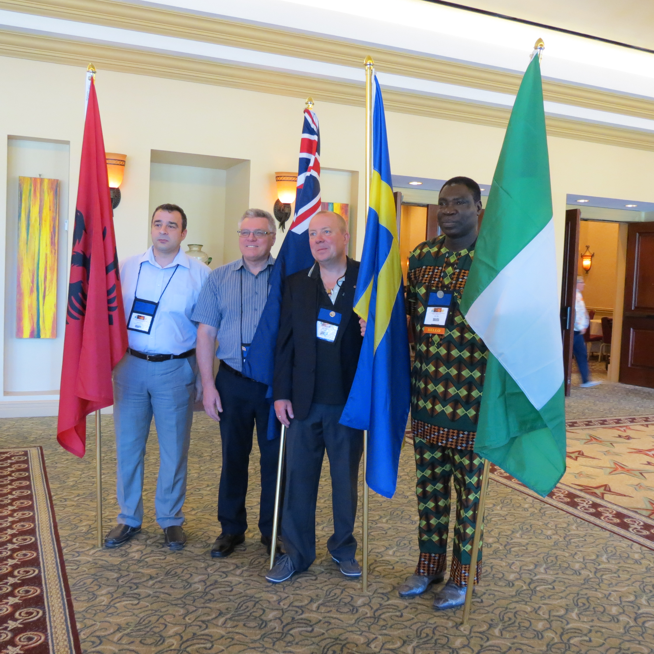
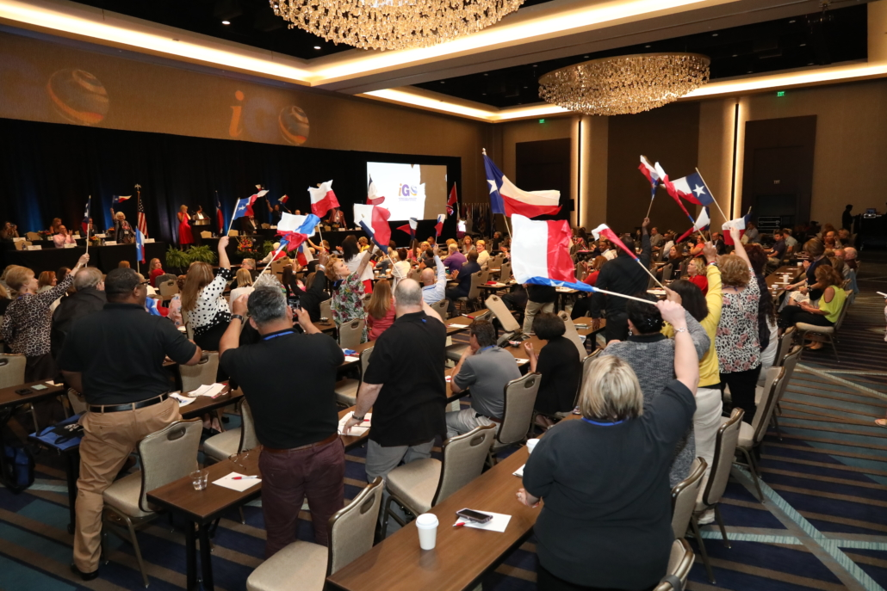
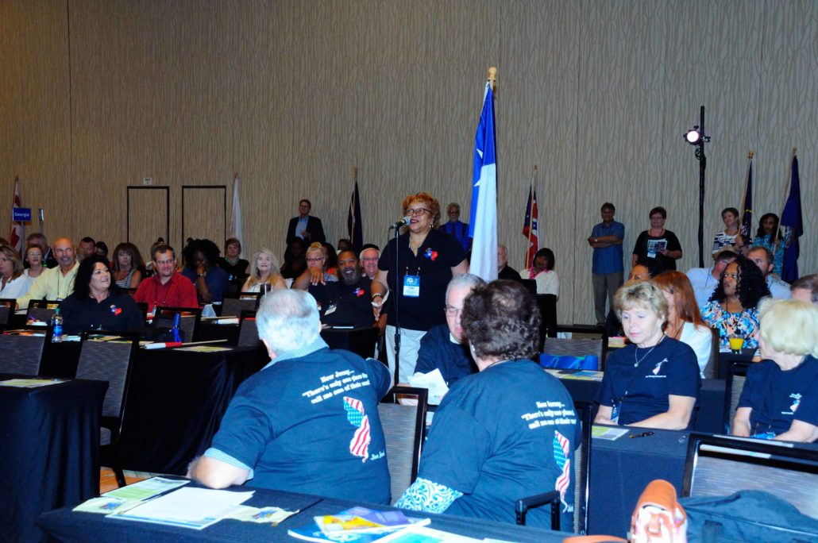
Mission & Vision
711 Members
49 States Represented
5 Countries Represented

Slide 5
Membership Benefits, Member Resources Continued Professional Development & Networking Opportunities
Continuing Education
Monthly Webinars
Trending Technology
Monthly eNews
Division –Specific
Two Annual Conferences Mid-Winter & Annual
Innovative Educational Offerings
Certificate in Public Leadership
Certified Public Official Credentials
iGo App available in Apple and Android App Store
Job Board
Division- Specific and joint-division sessions
Largest annual industry trade show
Networking and information app availalble to attendees
Archived webinars

Slide 6
Member Benefits
Other Benefits
iGO focuses on education and professional certification for government officials to help them succeed at their jobs. Various formats are used including learning sessions, roundtable discussions, best practices, and one-on-one interactions.
Joining iGO grants access to free monthly webinar on topics pertinent to the duties of Clerks, Recorders, Election Officials and Treasurers.
iGO monitors national issues that affect members and provides information on the hottest topics
Members network with others across the U.S. and internationally, sharing advice on issues faced by peers.

Slide 7
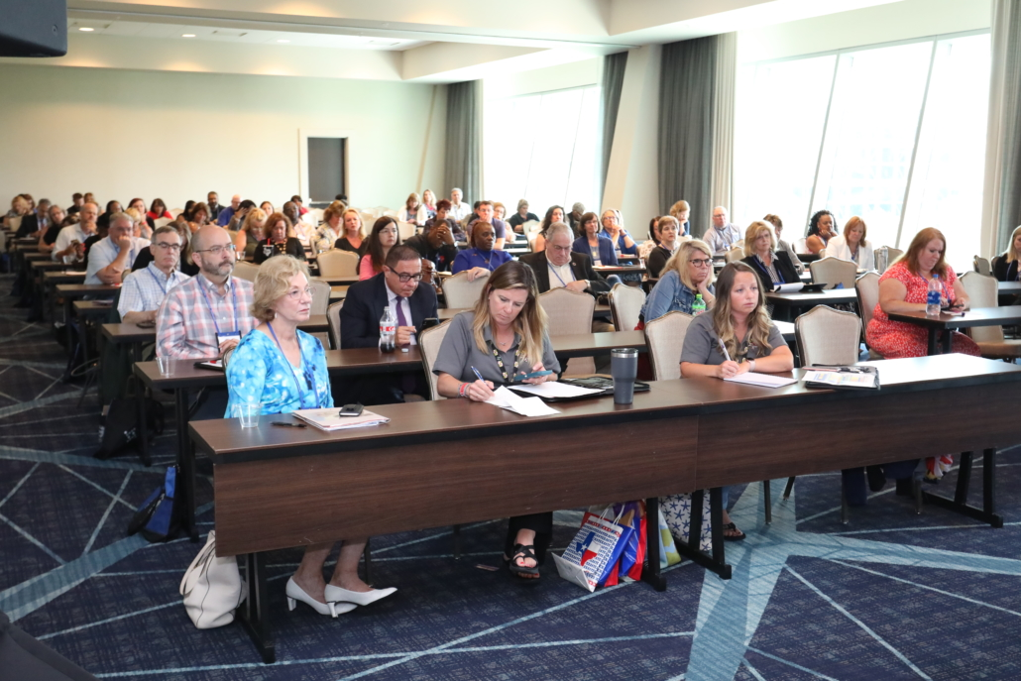
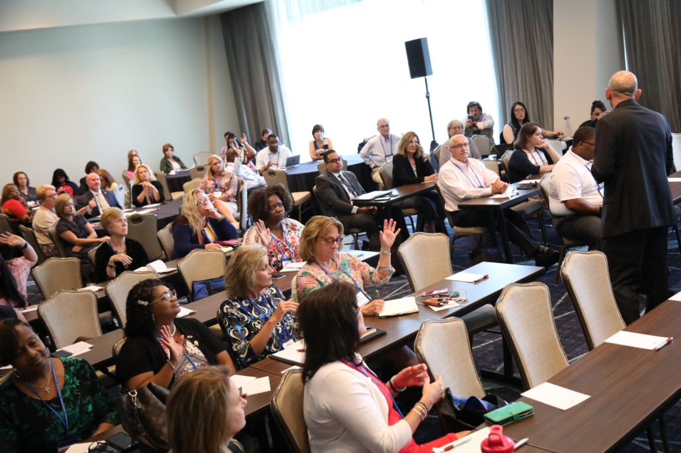
Member Benefits
Session Breakouts and Round Table Discussions
Members network with others across the U.S. and internationally, sharing advice on issues faced by peers.

Slide 8
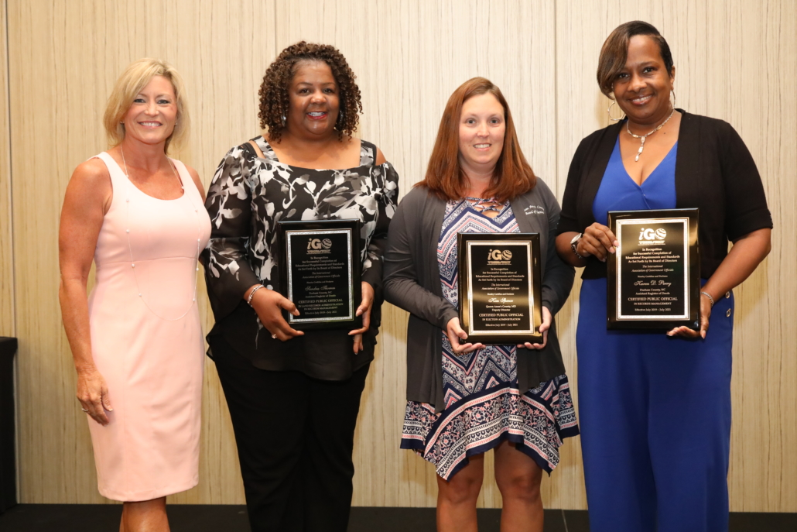
CERTIFICATES
CPL PROGRAM
The Certificate in Public Leadership (CPL) is specifically designed for all public officials, elected or appointed, and their staff. The courses are developed and conducted by faculty members of Pepperdine University. The CPL classes are offered in conjunction with iGO’s Annual Conference and Mid-Winter Conference, as well as during specific time periods online. The classes are comprehensive, focusing on the core principles of public service.
CPL Certificate – Certificate of Public Leadership

Slide 9
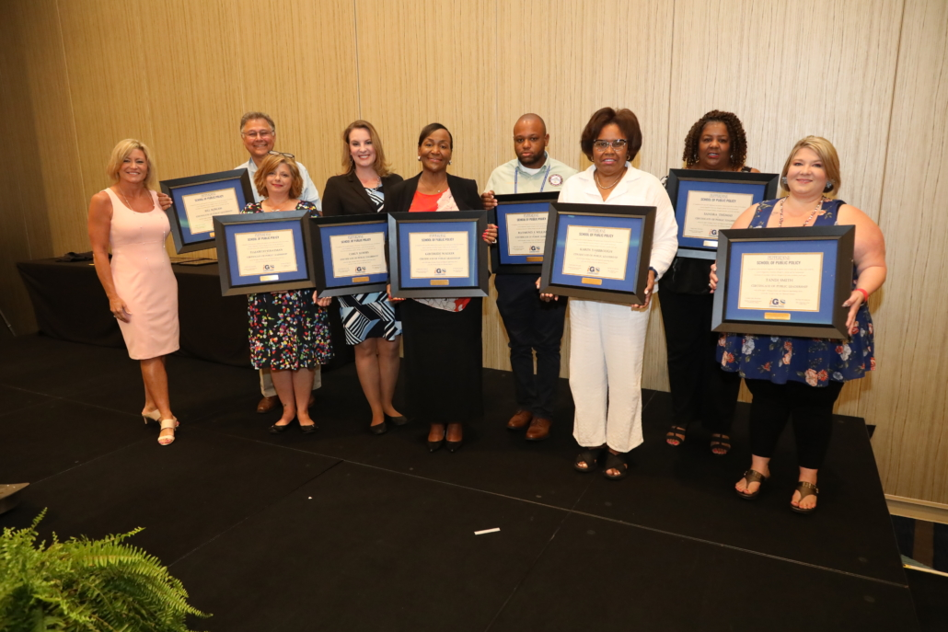
CERTIFICATES
CPO PROGRAM
iGO members have an opportunity to earn professional credentials through the Certified Public Officials (CPO) Program. iGO offers this program to members. Certified Public Official designations are awarded at the iGO Annual Conference, held each summer. Along with the privilege of using the “CPO” designation beside their signature, CPOs also receive a display plaque recognizing achievement as a Certified Public Official.
CPO PROGRAM- Certified Public Official

Slide 10
WEBINARS
Webinars – Continuing Education on Demand
All archived webinars are Free for iGo members, Below are some webinar topics;
Working with Sister Agencies in Managing Technology initiatives
A Practical Application of How Blockchain is Impacting Local Government
Vote at Home Envelopes and Inserts: How to Design for Voters, Election Offices, and USPS
Writing your budget: How to Tell your office’s Money-Story
Government Audits: What are they and How Can They Help?

Slide 11
AWARDS -
Innovator Award
The new iGO Innovator Award will be awarded to individuals in the Elections, Recorders, Clerks and Treasurers division in honor of their unique achievements and best practices in their respective fields.
Guidelines and Eligibility Requirements:
The best practice must reflect the current level of service or program performed by your office.
The service or program must be unique to your area.
All submissions must be typed and consist of no more than 5 pages including any supplemental materials.
Each office may submit no more than one application.

Slide 12
AWARDS -
Excellence in County Government Award
The International Association of Government Officials’ (iGO) Excellence in County Government Award was created to recognize an iGO member who exemplifies leadership, provides excellence in his/her office and is of the highest integrity. Please nominate the person you feel is most deserving of this award.
Guidelines and Eligibility Requirements:
Has exemplified leadership, ingenuity, provided excellence in his/her office and is of the highest Integrity,
Has been a member of a government officials association for at least five years,
Has been active in attending iGO’s Annual Conferences.

Slide 13
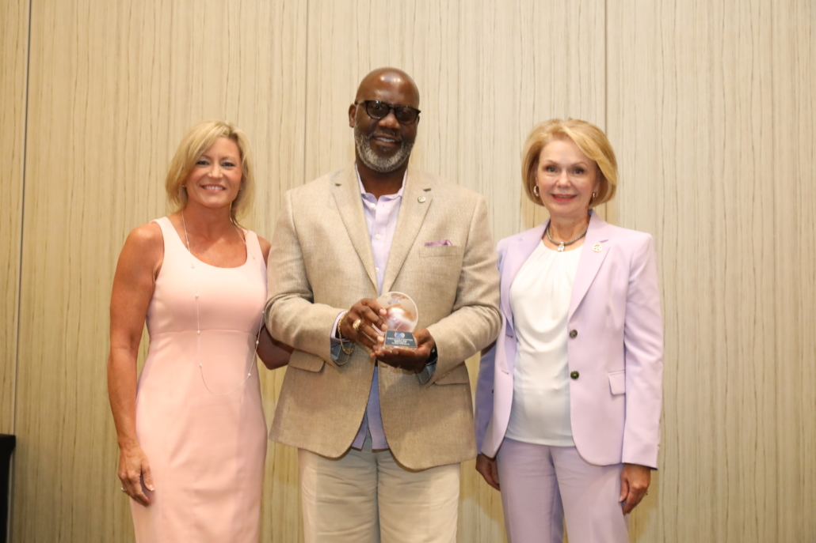
AWARDS -
Excellence in County Government Award
Michael Winn 2019 Excellence in County Government Award Recipient

Slide 14
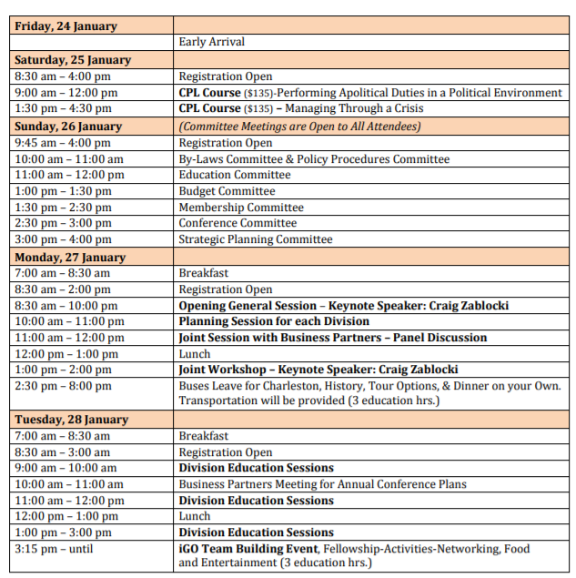
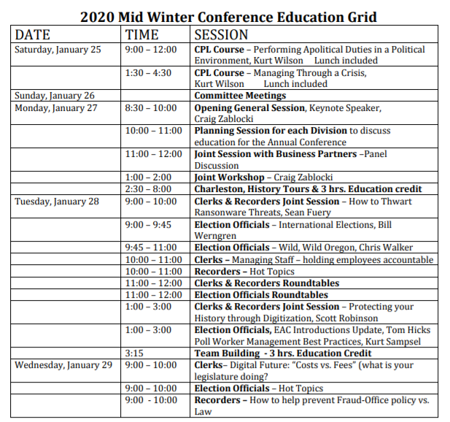
iGO at a Glance 2020

Slide 15
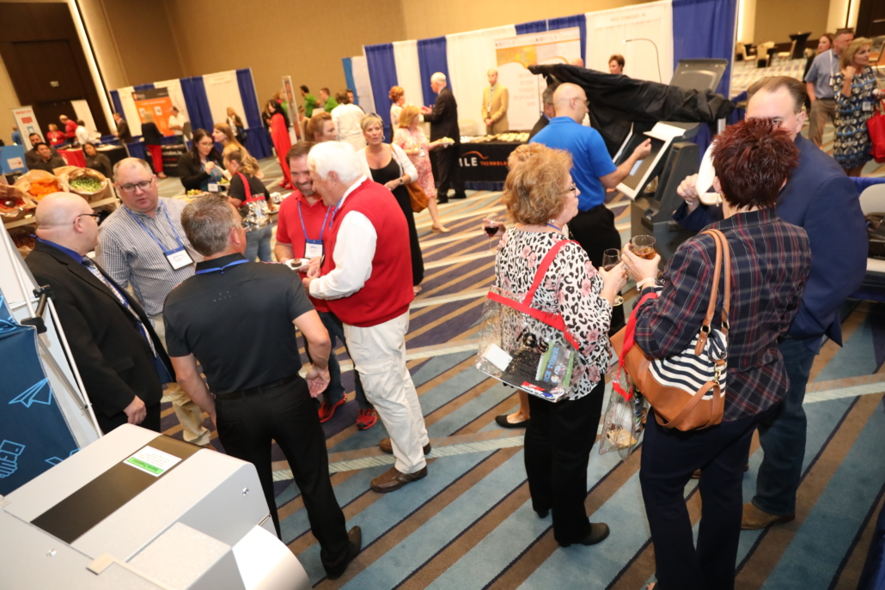
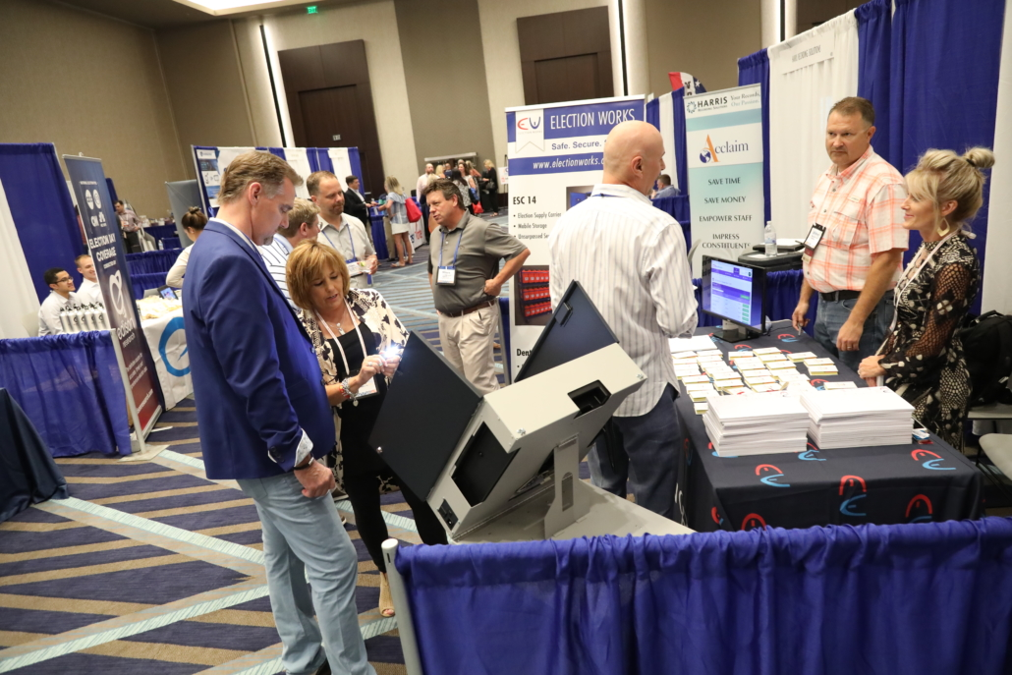
ANNUAL CONFERENCES
Mid-Winter Conference
The Mid-Winter Conference also involves members in the organization’s development through its committees.
Annual Conference
The annual conference is held in the Summer and includes iGo Trade Show. The Trade Show allows Conference Attendees to interact with business partners to experience the latest technologies.

Slide 16
GIVING BACK TO THE LOCAL COMMUNITY
Giving Back - During the Annual conference a Local Charity is selected for an iGO Donation and an Annual Blood Drive is also hosted by a local selected Blood Bank.
During the Annual conference 3 Scholarships are issued to iGO member’s child or grandchild for continuing education.
Trade Show consist of over 65 vendors ready to introduce you to the newest technology.

Slide 17
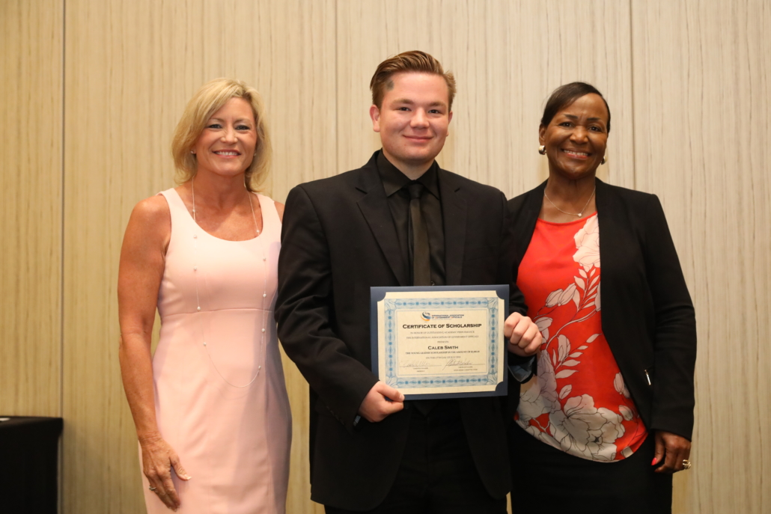
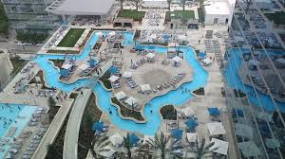
GIVING BACK TO THE LOCAL COMMUNITY
During the Annual conference 3 Scholarships are issued to iGO member’s child or grandchild for continuing education.
Houston Marriott Marquis, Caleb Smith
Received 2019 Top Scholarship

Slide 18
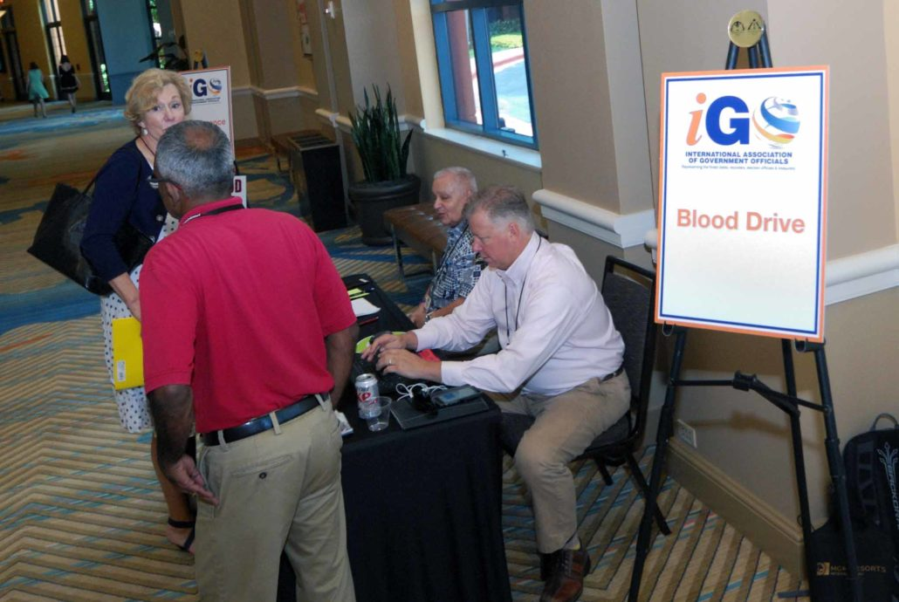
ANNUAL BLOOD DRIVE
ANNUAL BLOOD DRIVE: YOU GAVE THE GIFT OF LIFE!
In 2019 we had 17 successful donors give blood during the 2019 Annual Conference! That can save up to 54 lives!

Slide 19
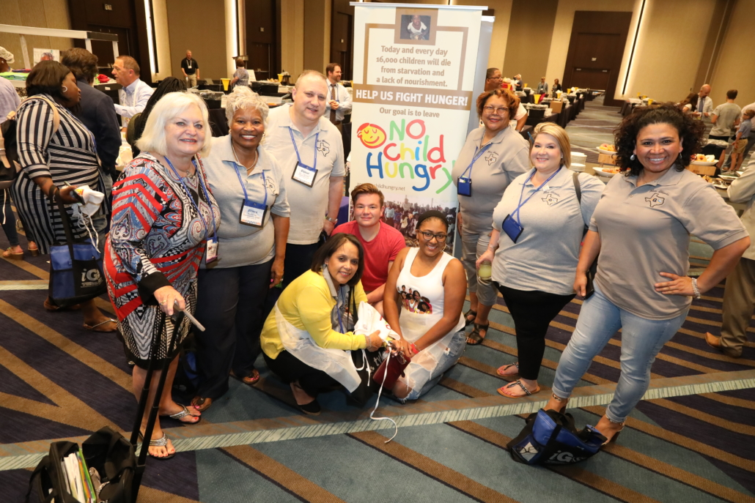
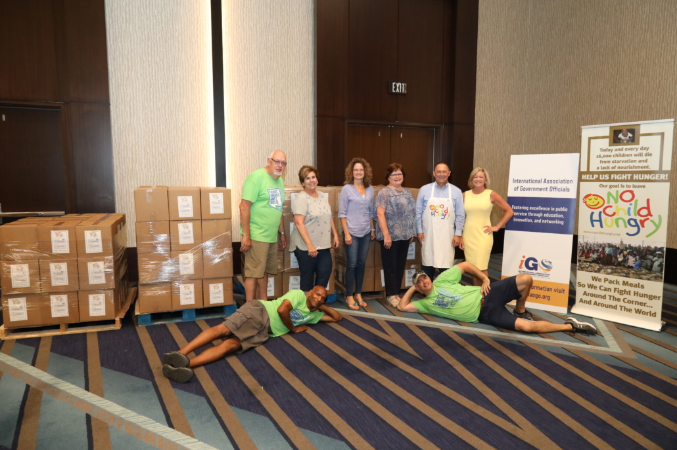
ANNUAL CHARITY
This year President Walker chose the No Child Hungry as our Charity for Conference and we raised $7,250!
We also packed over 36,000 meals that offer the nutrition a child needs each day and contained 21 minerals and vitamins along with soy protein and rice.

Slide 20
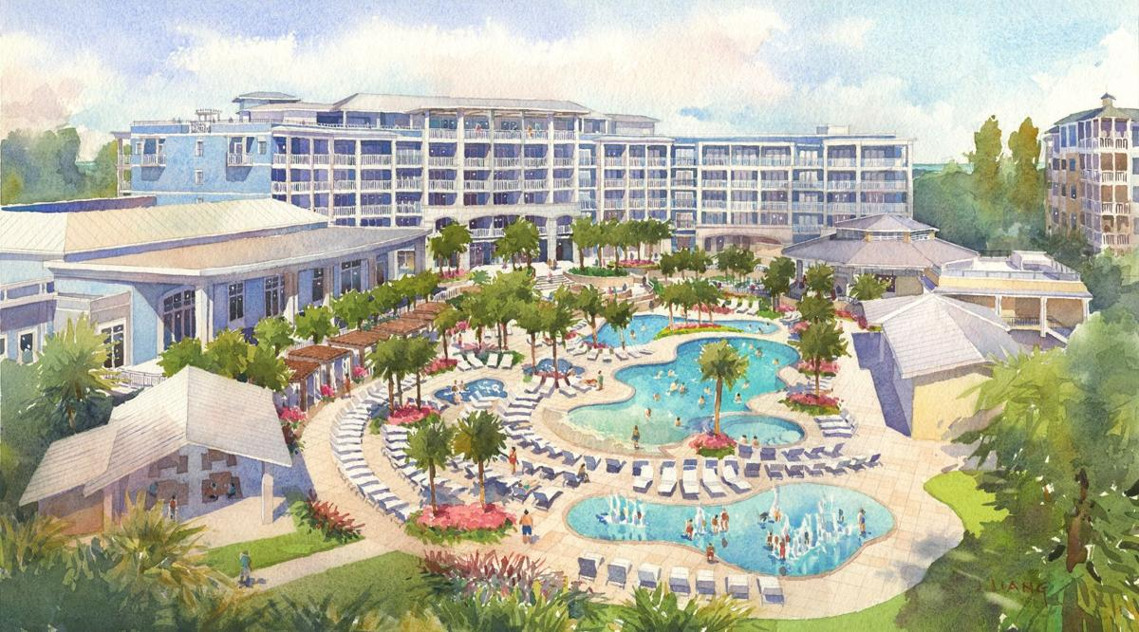
UPCOMING CONFERENCES - 2020
Mid Winter Conference
WILD DUNES ISLE OF PALMS SC JANUARY 24 – 30, 2020
Isle of Palms is located in Charleston County and a jewel in South Carolina’s Crown. Historic Charleston and Isle of Palms
https://www.destinationhotels.com/hotels-and-resorts/wild-dunes-resort
See You There!

Slide 21
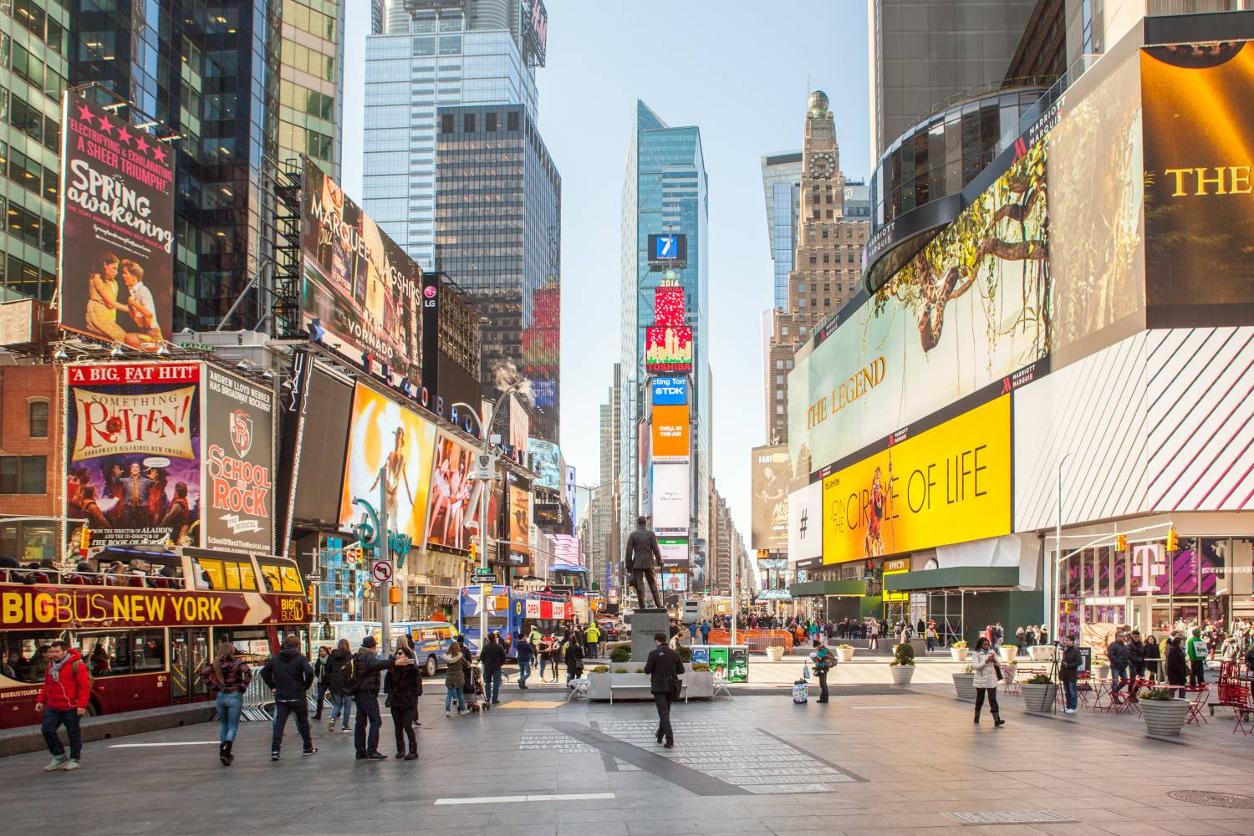
UPCOMING CONFERENCES - 2020
4th Annual Conference
July 23 – July 30, 2020
Sheraton New York Times Square room rate $219.00++
811 7th Avenue New York, NY 10019
https://www.marriott.com/hotels/travel/nycst-sheraton-new-york-times-square-hotel/?scid=bb1a189a-fec3-4d19-a255-54ba596febe2

Slide 22
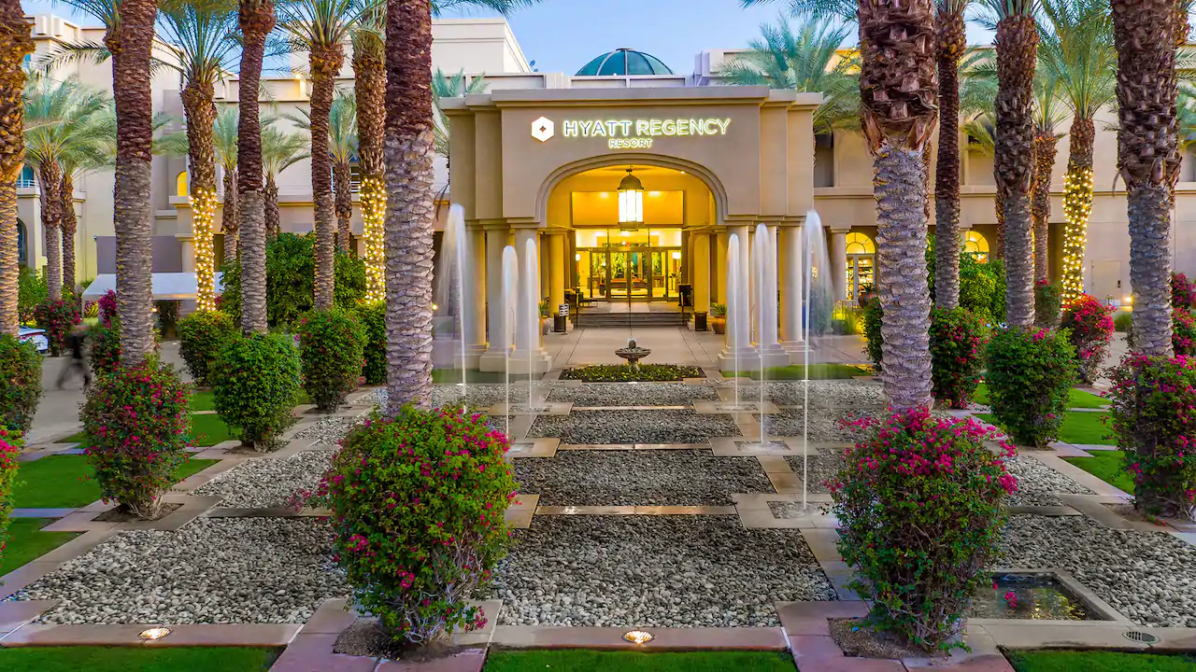
UPCOMING CONFERENCES - 2021
iGO’s Annual Conference will be in Palm Springs, CA, July 17-21, 2021
Hyatt Regency Indian Wells Resort And Spa
Hope To See You There!

Slide 23
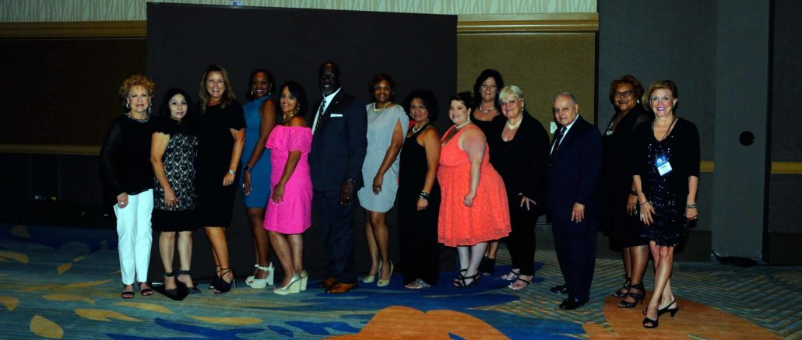
TEXAS DELEGATES 2017

Slide 24
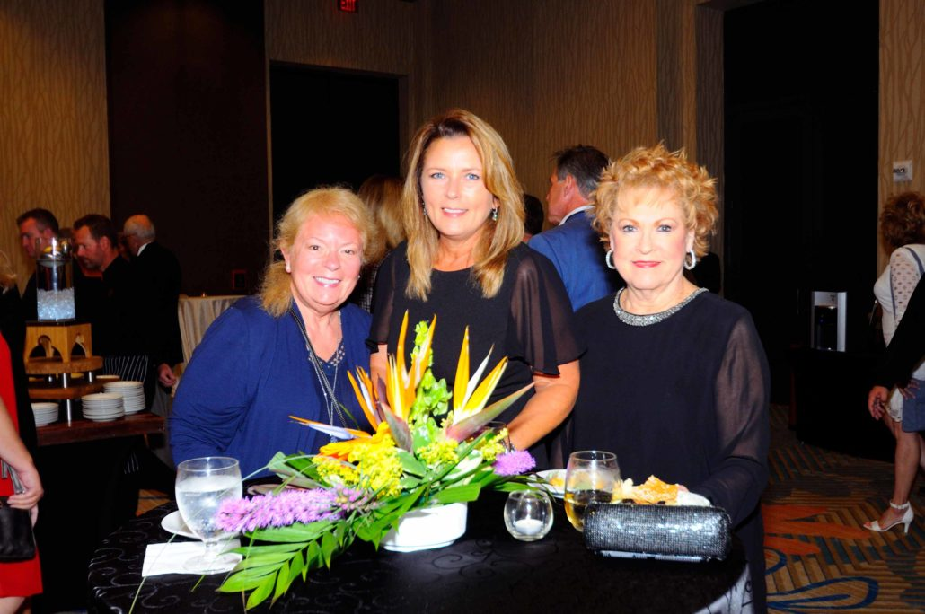
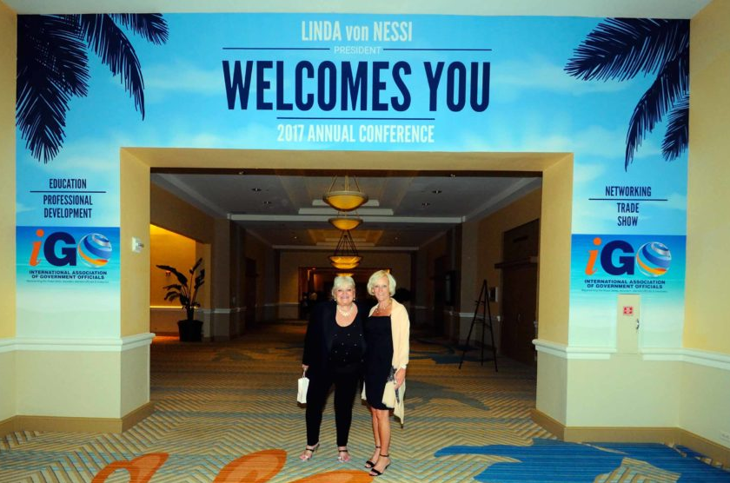
OTHER TEXAS DELEGATES

Slide 25
JOIN TODAY
Why Wait, JOIN TODAY!
Pick up an information Handout and fill out the new Membership Application.
Thank you for your attention!
Toni Pippins – Poole
For More Information Visit
https://iaogo.org/

